Slide 1
Phase Rule & Phase Diagram

Slide 2
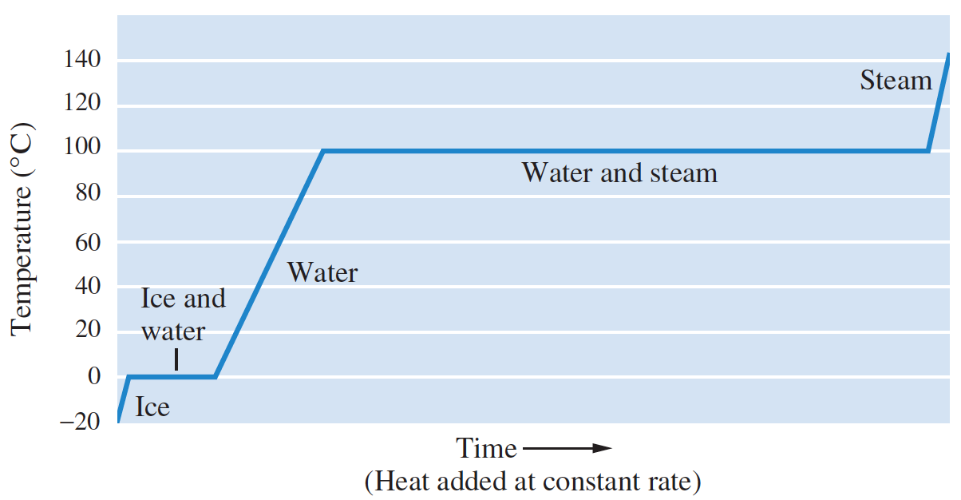
Phase Transitions
The heat needed for the melting of a solid is called the heat of fusion (or enthalpy of fusion) and is denoted ΔH_{fus}.
H₂O(s) ➔ H₂O(l); ΔH_{fus} = 6.01 kJ/mol
The heat needed for the vaporization of a liquid is called the heat of vaporization (or enthalpy of vaporization) and is denoted ΔH_{vap}.
H₂O(l) ➔ H₂O(g); ΔH_{vap} = 40.7 kJ/mol

Slide 3

Clausius–Clapeyron Equation: Relating Vapor Pressure & Liquid Temperature
The vapor pressure of a substance depends on temperature.
It can be shown that the logarithm of the vapor pressure of a liquid or solid varies with the absolute temperature according to the following approximate relation:
Here ln P is the natural logarithm of the vapor pressure, and A and B are positive constants.
Plot of ln P versus 1/T should give a straight line with slope –A.

Slide 4
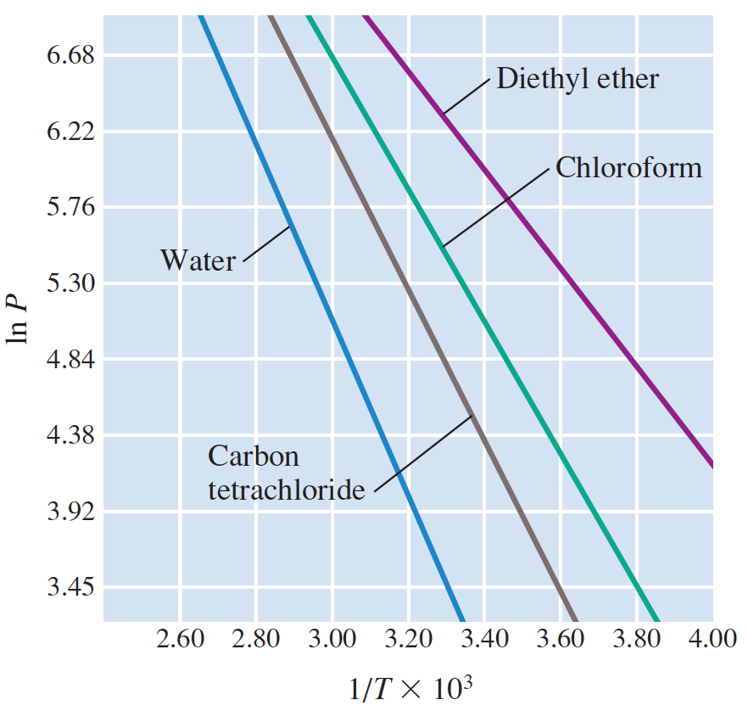
This equation has been derived from thermodynamics, by
assuming the vapor behaves like an ideal gas.
Slope = –A

Slide 5

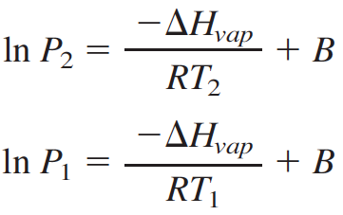
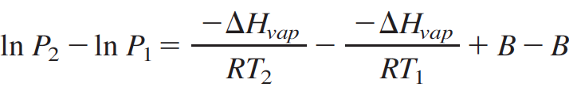
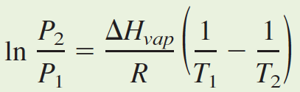
The result, known as the Clausius–Clapeyron equation, shows that the constant A is proportional to the heat of vaporization of the liquid, ΔH_{vap}.
A two-point form of the Clausius–Clapeyron equation is very useful for calculations. Let us write the previous equation for two different temperatures:
Here P₁ is the vapor pressure at absolute temperature T₁, and P₂ is the vapor pressure at absolute temperature T₂. If you subtract the second equation from the first, you get
Or,

Slide 6
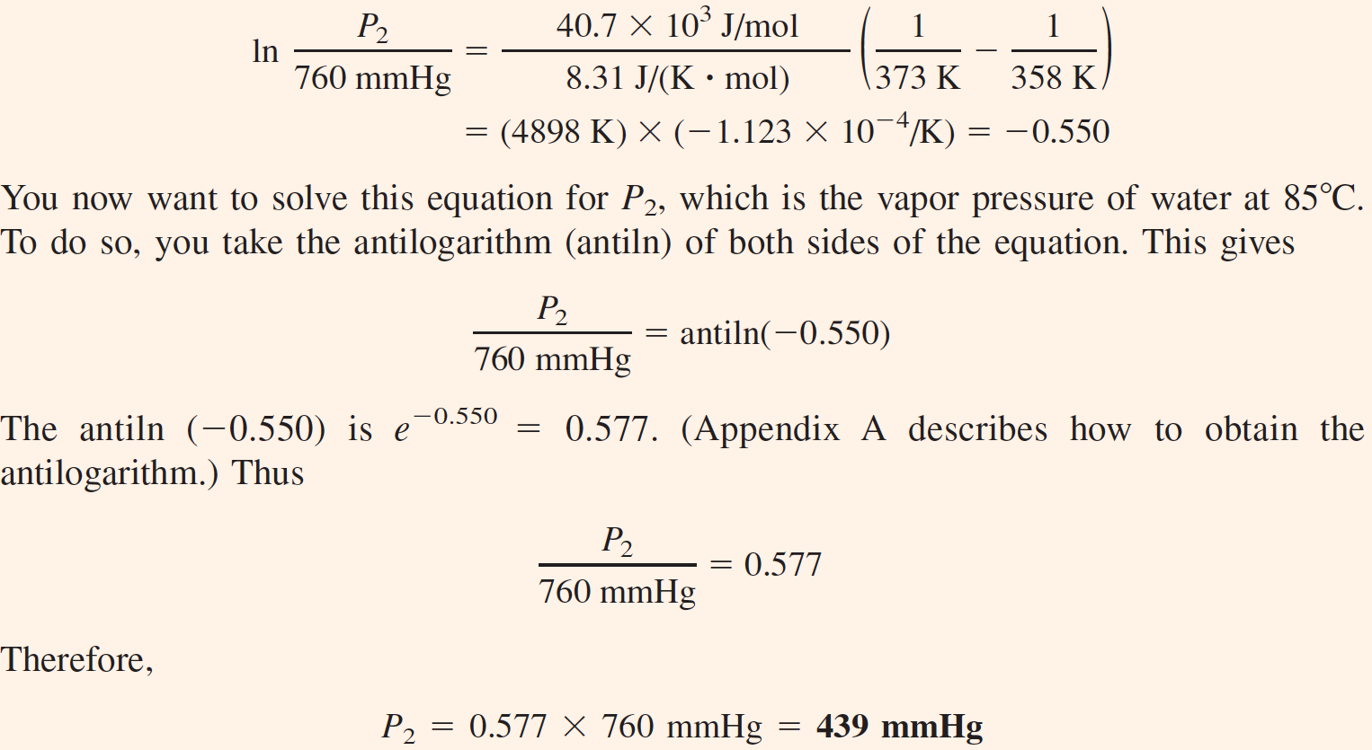

Slide 7
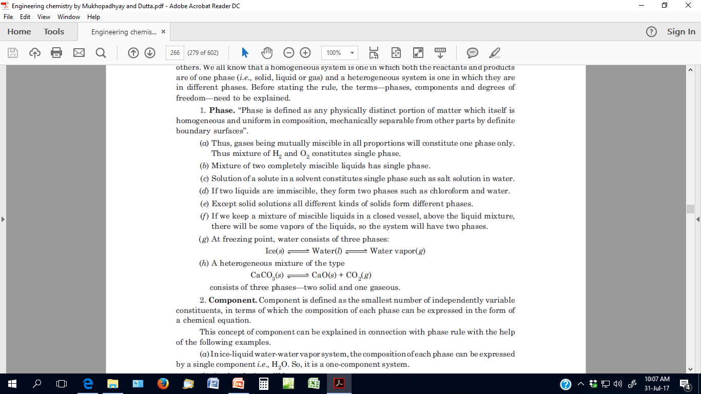

Slide 8
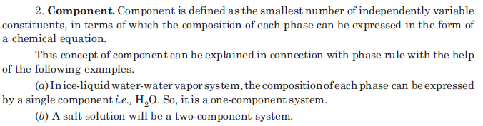
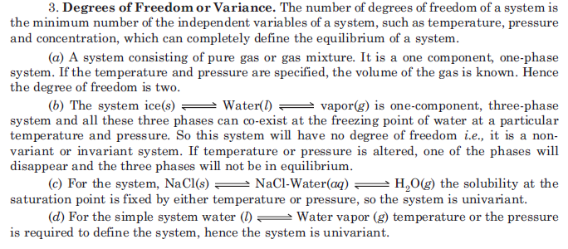

Slide 9
Phase Rule
Phase Rule: For a system at equilibrium the phase rule relates:
P = number of phases that can coexist, to
C = number of components making up the phases, and
F = degrees of freedom. Where these three variables are related in the equation
F = C – P + 2
The degrees of freedom represent the environmental conditions which can be independently varied without changing the number of phases in the system. Conditions include:
Temperature
Pressure
Chemical Composition etc.

Slide 10
Phase Diagram
Phase Diagram: A phase diagram is a graphical way to summarize the conditions under which the different states of a substance are stable.

Slide 11
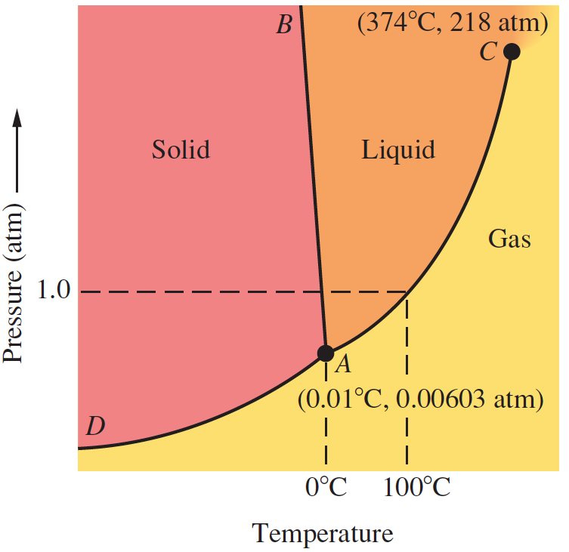
Phase Diagram – H₂O
The curves AB, AC, and AD divide the diagram into regions that give combinations of temperature and pressure for which only one state is stable.
Along any curve, the two
states from the adjoining regions are in equilibrium.
F = C – P + 2
= 1 – 2 + 2
= 1
Solid Liquid

Slide 12
Curve AB : F = 2
Divides the solid region from the liquid region, represents the conditions under which the solid and liquid are in equilibrium.
Curve AC: F = 2
Divides the liquid region from the gaseous region gives the vapor pressures of the liquid at various temperatures.
Gives the boiling points of the liquid for various pressures.
Curve AD: F = 2
Divides the solid region from the gaseous region gives the vapor pressures of the solid at various temperatures.
This curve intersects the other curves at point A, the triple point.
Triple Point A: The point on a phase diagram representing the temperature and pressure at which three phases of a substance coexist in equilibrium. F = C – P + 2 = 1 – 3 + 2 = 0
For water, the triple point occurs at 0.01°C, 0.00603 atm, and the solid, liquid, and vapor phases coexist.

Slide 13
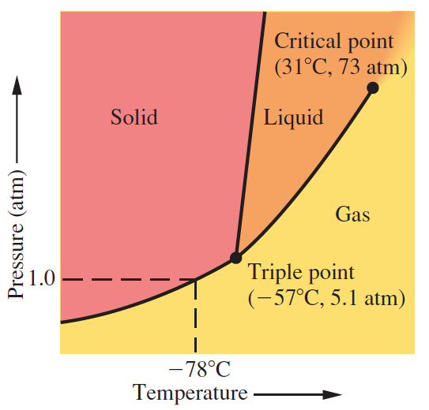
Phase Diagram – CO₂
The triple point of CO₂ is at –57 °C and 5.1 atm.
Therefore, the solid sublimes if warmed at any pressure below 5.1 atm.
This is why solid CO₂ sublimes at normal atm pressure (1 atm).
Above 5.1 atm, however, the solid melts if warmed.

Slide 14
Critical Temperature and Pressure
The temperature above which the liquid state of a substance no longer exists regardless of the pressure is called the critical temperature (31 °C for CO₂).
The vapor pressure at the critical temperature is called the critical pressure (73 atm for CO₂).
It is the minimum pressure that must be applied to a gas at the critical temperature to liquefy it.
In figure, the top ends at a point at which the temperature and pressure have their critical values. This is the critical point.
Many important gases cannot be liquefied at room temperature.
N₂ has a critical temperature of –147 °C. This means the gas cannot be liquefied until the temperature is below –147 °C.

Slide 15
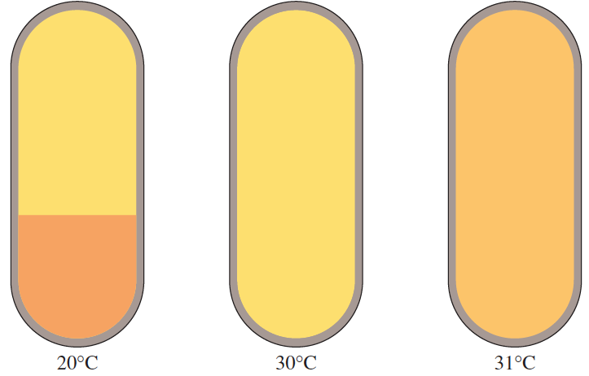
Observing the Critical Phenomenon
A B C
(A) CO₂ liquid in equilibrium with its vapor at 20 °C. (B) The same two states in equilibrium at 30 °C ( just below the critical point); the densities of the liquid and vapor are becoming equal. (C) CO₂ at 31 °C (the critical temperature); the liquid and vapor now have the same densities—in fact, the distinction between liquid and vapor has disappeared, resulting in what is called a supercritical fluid.

Slide 16
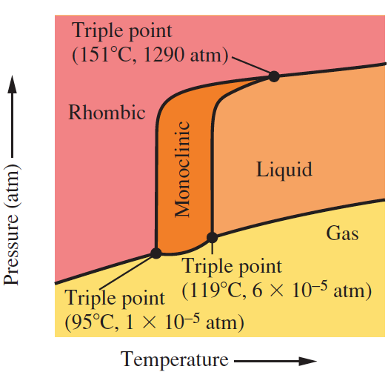
Phase Diagram – Sulfur
This substance has a complicated phase diagram with three triple points.

Slide 17
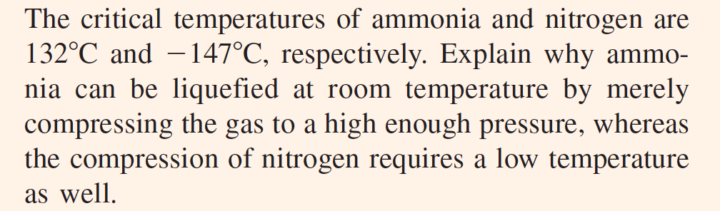
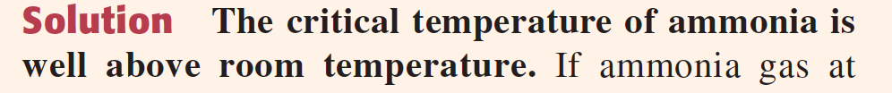
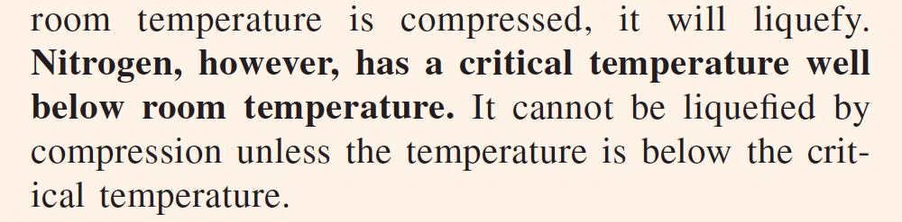

Slide 18
Self-Ionization of Water and pH

Slide 19
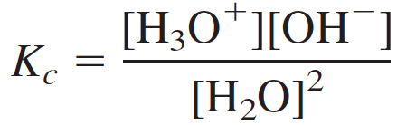
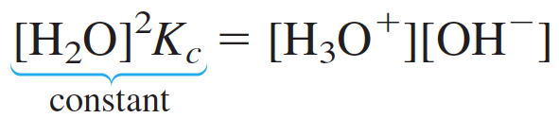
Self-Ionization of Water
Self-ionization is a reaction in which two like molecules react to give ions. In the case of water, a proton from one H₂O molecule is transferred to another H₂O molecule, leaving behind an OH⁻ ion and forming a hydronium ion, H₃O⁺(aq).
The equilibrium constant of the self-ionization of water Kc is:
Because the concentration of ions formed is very small, the concentration of H₂O remains essentially constant
We call the equilibrium value of the ion product [H₃O⁺][OH⁻] the ion-product constant for water, which is written K_{w}.
Thus, the concentrations of H₃O⁺ and OH⁻ are both 1.0 × 10⁻⁷ M in pure water.

Slide 20
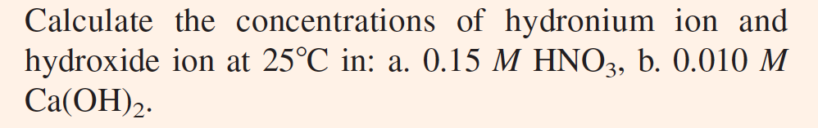
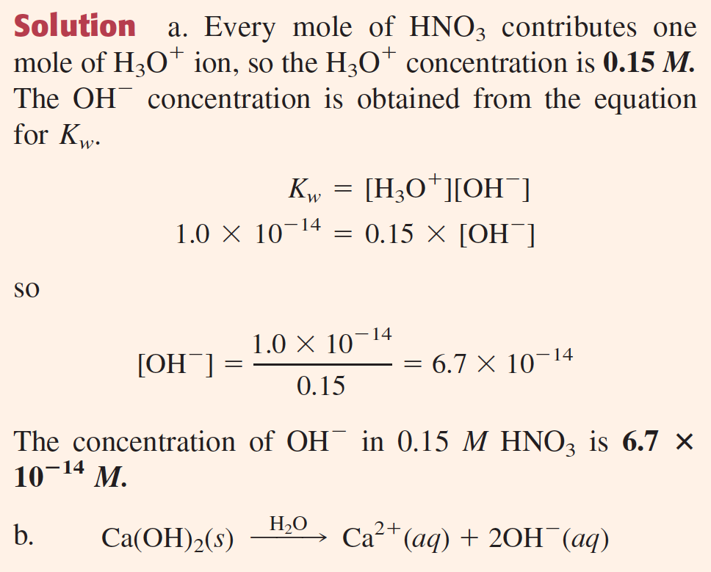
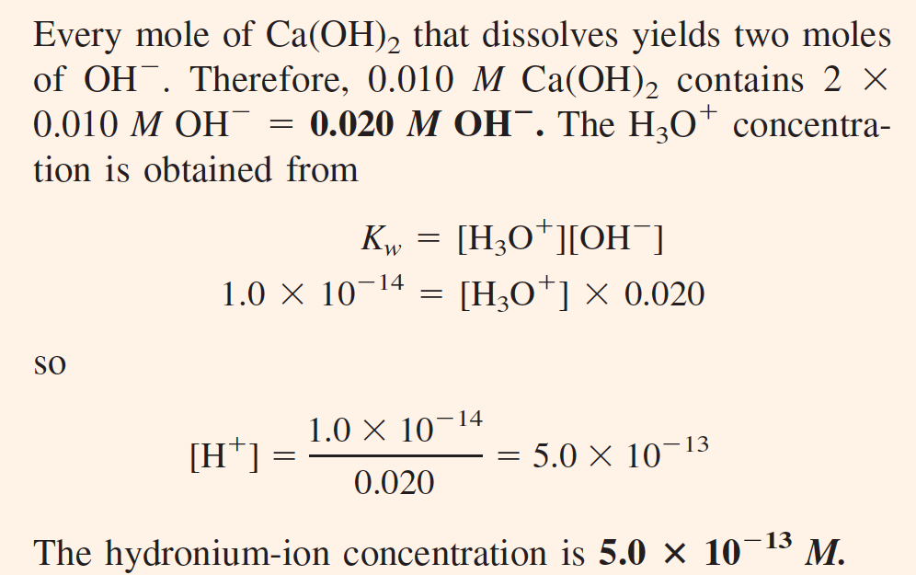
Solutions of a Strong Acid or Base

Slide 21



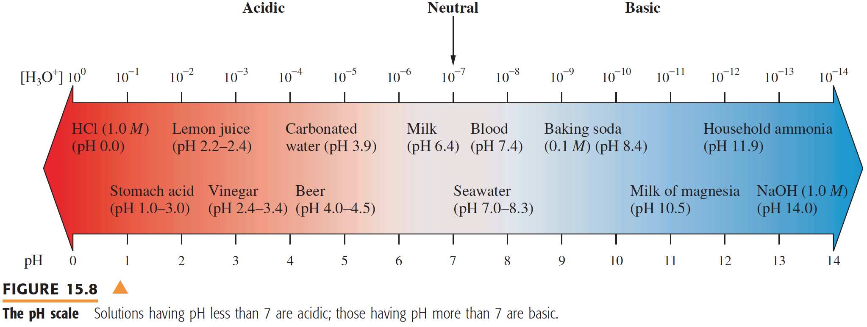
The pH of a Solution
pH is defined as the negative of the logarithm of the molar hydronium-ion concentration:

Slide 22


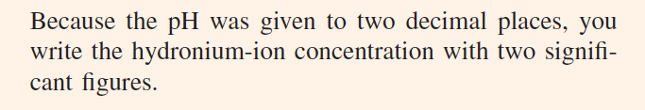
The pH of a Solution

Slide 23
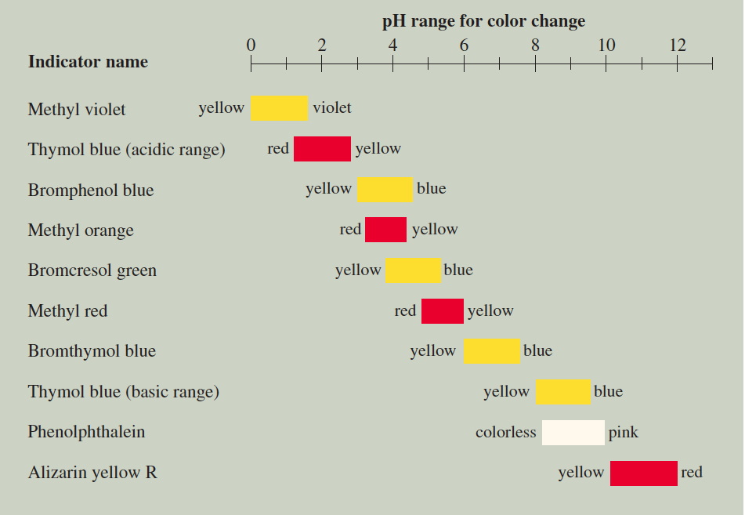
Acid–base indicators are dyes whose acid form has one color and whose base form has another color.

Slide 24
pH Problems
What happens when you mix two solutions of two different pHs?

